Slide 1
Visualising Data Mesh
A Paradigm Shift in Data Management
(Applied DevOps to the world of Data Analytics)
Anurag Kale
Cloud and Data Architect at Aurobay Sweden AB
Notes:
Engage the audience a little bit.
How many of you are engineers?
How many of you are managers or people with management roles?
If you desire to step up into leadership roles, either as an IC or as a Manager, this talk is for you.

Slide 2
A Paradigm Shift in Data Management
(Applied DevOps to the world of Data Analytics)
Anurag Kale
Cloud and Data Architect at Aurobay Sweden AB
AWS Data Hero | Gothenburg, Sweden
Notes:
Engage the audience a little bit.
How many of you are engineers?
How many of you are managers or people with management roles?
If you desire to step up into leadership roles, either as an IC or as a Manager, this talk is for you.

Slide 3
Agenda
Data Analytics challenges
DevOps as inspiration
Data Mesh & it’s 4 principles
Architectural pre-requisites
Reflections from trenches

Slide 4
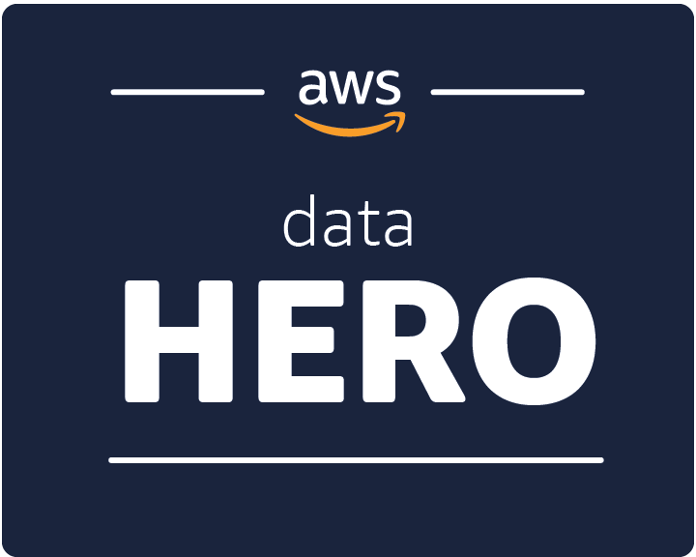
$whoami
Anurag Kale
Cloud and Data Architect
Aurobay Sweden AB
Gothenburg, Sweden
@iAnuragKale

Slide 5
About me
AWS Data Hero since May 2021
~10+ years in the IT industry
Worked in Consultancy, Startups, Product and Enterprises
Worked as Developer, Operations and Architect in application and data world
Work at Aurobay Sweden AB (part of HORSE Powertrain Ltd. )

Slide 6
Data functions in Enterprises
Brittle, Ops heavy
Application1
Reports
ETL/ELT
Application 2
DWH / Data Lakehouse
Application 3
Dashboards
Application N
Data Engineers, ETL Developers,
BI Developers, Data Analysts, Data Architects etc
Machine Learning
Can’t freely access data
Bottleneck, gatekeepers

Slide 7
Application functions a few years ago
Brittle, Ops heavy
Application1
Build
Application 2
Operations centre
Application 3
Application
Application N
Build engineers, Production Support, Operations, SOC
Can’t freely access logs
Bottleneck, gatekeepers

Slide 8
DevOps Revolution

Slide 9
Cross functional teams
Designer
Digital
Product
Dev
Ops
InfoSec
Product Manager
QA

Slide 10
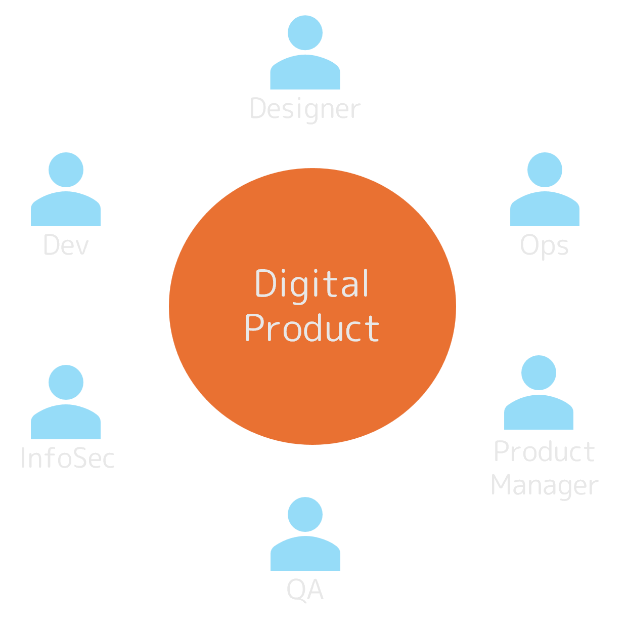
Cross functional teams
Value Stream 1
Why don’t we have any data personas?
Value Stream 2

Slide 11
What if we apply this to Data world?
Here comes Data Mesh

Slide 12
“Data Mesh is a decentralized sociotechnical approach to share, access, and manage analytical data in complex and large-scale environments – within or across organisations”
Zhamak Dehgani – Author Data Mesh

Slide 13
Domain Ownership
Data as a Product
Self Serve Data Platforms
Federated Governance

Slide 14
Domain Ownership

Slide 15
Domain Ownership - 1
Brittle, Ops heavy
Application1
Reports
ETL/ELT
Application 2
DWH / Data Lakehouse
Application 3
Dashboards
Application N
Data Engineers, ETL Developers,
BI Developers, Data Analysts, Data Architects etc
Machine Learning
Can’t freely access data
Bottleneck, gatekeepers

Slide 16
Domain Ownership - 2
Brittle, Ops heavy – product responsibility
Application1
Reports
ETL/ELT
Application 2
Data Engineer/s
DWH / Data Lakehouse
Application 3
Dashboards
Application N
Data Engineers, ETL Developers,
BI Developers, Data Analysts, Data Architects etc
Machine Learning
Can now freely EXPOSE data at their will
Enablers, gatekeepers

Slide 17
Domain Driven Design - Context Map
Bounded context
Reservation
Payments
U
Conformist
D
customer supplier
Display
Published Language
Payments
generic sub-domain
User Mgmt
Reservation
core sub-domain
Audit
Security
supporting sub-domain

Slide 18
Domain Ownership
Data as a Product
Self Serve Data Platforms
Federated Governance

Slide 19
Data as a Product

Slide 20
Domain Ownership - 2
Brittle, Ops heavy – product responsibility
Application1
Reports
ETL/ELT
Application 2
Data Engineer/s
Requires Product and Data Teams to sync before any changes
Change management is still a nightmare
Product data knowledge is not democratized
DWH / Data Lakehouse
Application 3
Dashboards
Application N
Data Engineers, ETL Developers,
BI Developers, Data Analysts, Data Architects etc
Machine Learning
Can now freely EXPOSE data at their will
Enablers, gatekeepers

Slide 21
Reports
Application
DWH / Data Lakehouse
Dashboards
Data + Metadata aka
Data Product
Machine Learning
OPEN DATA PRODUCT SPECIFICATION
Linting
SLAs
Quality
Etc
OPEN DATA CONTRACTS

Slide 22
Domain Ownership
Data as a Product
Self Serve Data Platforms
Federated Governance

Slide 23
Self Serve Data Platforms

Slide 24
Reports
What about COTS?
What if everyone exposes data in different ways?
Over-engineering?
Application
DWH / Data Lakehouse
Dashboards
Data + Metadata aka
Data Product
Machine Learning

Slide 25
Application
DWH / Data Lakehouse
Report
Dashboards
Machine Learning
Data + Metadata
Data Product
Enabling Data Platform
Compute | Catalog | Policy | Governance
Standardization
Developer Accelerator
Gatekeepers -> Custodians
Application 2
RAG / Data Science
Data + Metadata
Data Product
Local Feedback Loops

Slide 26
Enabling Data Platform
Compute | Catalog | Policy | Governance
Data Catalog
On demand compute
Blueprints
X based access control
Audit logs
Observability

Slide 27
Stream aligned Data Products
i.e. Local optimum
Business aligned Data Products
i.e. Global optimum
Application1
Reports
How?
DWH / Data Lakehouse
Application 2
Dashboards
Application 3
Data Engineers, ETL Developers,
BI Developers, Data Analysts, Data Architects etc
Machine Learning
Application N

Slide 28
Domain Ownership
Data as a Product
Self Serve Data Platforms
Federated Governance

Slide 29
Federated Governance

Slide 30
Stream aligned Data Products
i.e. Local optimum
Business aligned Data Products
i.e. Global optimum
Application1
Enabling Data Platform
Compute | Catalog | Policy | Governance
Reports
DWH / Data Lakehouse
Application 2
Dashboards
Application 3
Data Engineers, ETL Developers,
BI Developers, Data Analysts, Data Architects etc
Machine Learning
Enforce policies for data access
Provide a unified way to request access to data
(Policy as code)
Application N

Slide 31
Cross functional teams
Designer
Digital
Product
Dev
Ops
InfoSec
Product Manager
QA

Slide 32
New cross functional team
QA
Designer
Dev
Digital
Product
Ops
Product Manager
InfoSec
Data Engineer
Data Scientist

Slide 33
Personal Reflections
From a failed attempt of using Data Mesh as basis of our data strategy

Slide 34
What is your winning aspiration?
Where will you play?
Focused way too much on technical outputs, less on OUTCOMES
How will you win?
What capabilities must be in place?
What management systems are required?
Roger Martin’s Cascade of Choices for Strategy

Slide 35
What is your winning aspiration?
Where will you play?
How will you win?
What capabilities must be in place?
Underestimated lack of technical know-how amongst all department leaders
Lack of onboarding to exiting data personas
What management systems are required?
Roger Martin’s Cascade of Choices for Strategy

Slide 36
What is your winning aspiration?
Where will you play?
Bottom up initiative, engineering driven
Lacked executive sponsorship to put in management structures that allow for hiring of data personas
How will you win?
What capabilities must be in place?
What management systems are required?
Roger Martin’s Cascade of Choices for Strategy

Slide 37
Prerequisites

Slide 38
Architecture
Know your applications boundaries
Use Domain Driven Design if you don’t know them yet
Know the Information model or Taxonomy of your application landscape
This help to find your application boundaries
Have a robust Identity and Access Management platform that is generic and application agnostic
Build value stream maps to know a clear distinction between platforms and products

Slide 39
Organizational & Cultural Alignment
Tie the initiatives to a Business OUTCOME
Don’t make it a platform building or transformation excercise
Set OKR’s / KPI’s across the organisation that you want to reach
Invest in training for all personas – BA’s, PO’s, PM’s and business as well
Do DevOps gamedays, instil “You own it, you operate it” mentality across the board

Slide 40
Closing thoughts
Data Mesh’ing does not mean we get rid of centralised data teams
It’s a socio-technical approach, requires top-down buy-in
Data Mesh is striving for loose coupling, supports agility
Agile manifesto applied to Data Analytics
And some recommendations

Slide 41
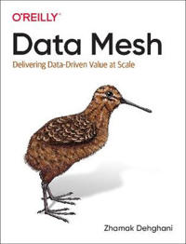
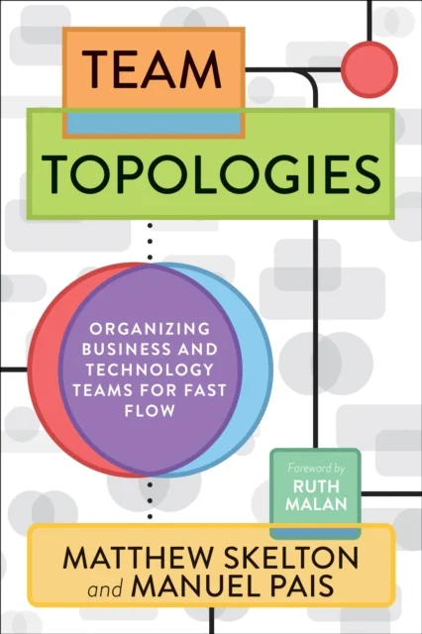
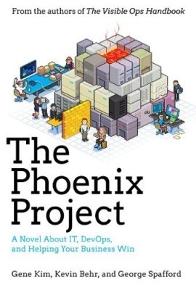
Notes:
This is when I started working for a startup which led me to dive deeper into the world of DevOps
DevOps to me then was – CI/CD,

Slide 42
Thank you for your attention
iAnuragKale

Slide 43
Thank you to our sponsors

Slide 44
Thank you! Feedback?
Questions?
iAnuragKale

Slide 45
Bringing it all together

Slide 46
Application
Data + Metadata
Data Product
Reports
Application
DWH / Data Lakehouse
Data + Metadata
Data Product
Dashboards
Machine Learning
Application
Data + Metadata
Data Product
Stream aligned Data Products
Business aligned Data Products

Slide 47
Application
DWH / Data Lakehouse
Report
Dashboards
Machine Learning
Data + Metadata
Data Product
Enabling Data Platform
Compute | Catalog | Policy | Governance
ETL responsibility of product team
With metadata we can confidently establish the meaning of data
Governed and trusted
Application 2
RAG / Data Science
Data + Metadata
Data Product
Local Feedback Loops

Slide 48
Domain Driven Design
To find the right granularity of data products

Slide 49
Understanding the subdomains
Core subdomain
Something the company does differently
Source of competitive advantage
Generic subdomain
Something everyone does
Complex but doesn’t provide any competitive advantage
Supporting subdomain
Functions that supports business operations
Low complexity, but does not provide any competitive advantage
Notes:
Shorten or change the way to do more graphically

Slide 50
Decision tree
Buy
Build
Generic
Core
Complexity
Outsource
Generic / Supporting
Supporting
Differentiation

