Slide 1
Building Data Lake Platform Fully Serverless
Anurag Kale
https://www.anuragkale.com
Notes:
Engage Audience :
Ask about how many of you know – Data Lakes ? Serverless? Use AWS ?
You are an engineer trying to level up and you get your first opportunity to influence the design of a solution. A natural place to start (before ChatCPT) would be google.

Slide 2
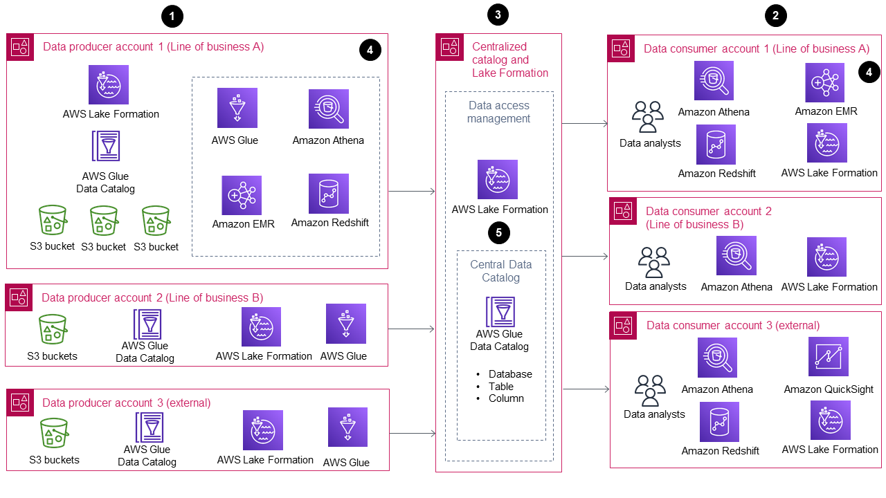
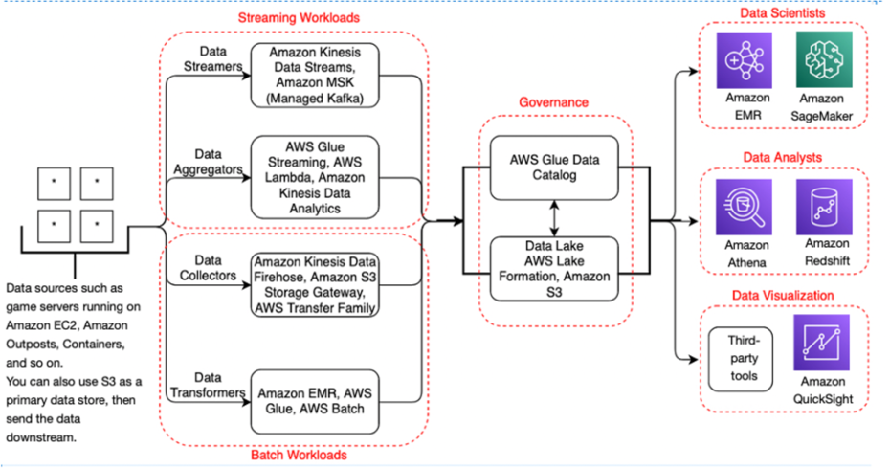
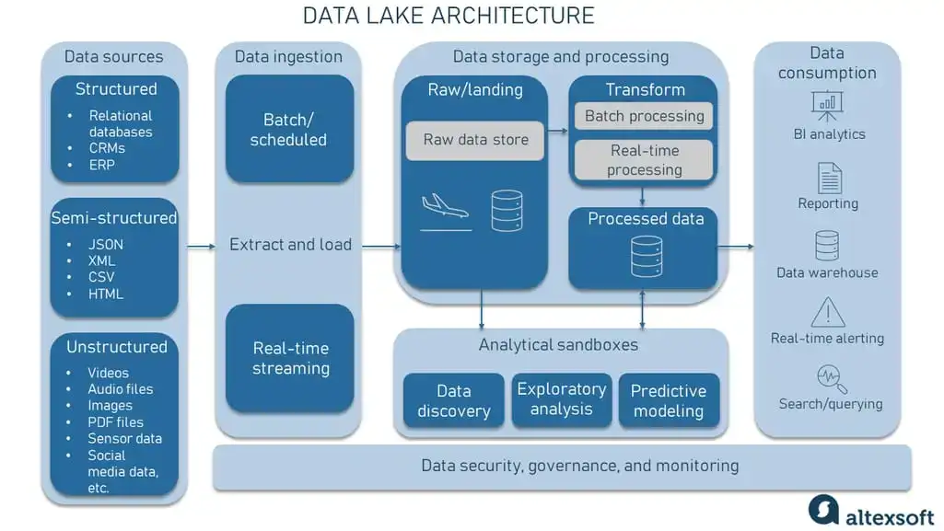
Asvine V126
Source: AWS
Source: AWS
Source: Altexsoft
Notes:
Someone told that a big company build a data lake for this kind of use case and you do what any engineer would do, google – Data Lake
You will get in most cases – a reference architecture or some sort of architecture patterns.
You find this diagram, really good, has plenty of details, but if you are someone like me, you want to understand the building blocks of the system so, you search more and find something like this.
Again a very nice diagram with a lot of details, but you do not have any indications to suggest what may or may not work for you.
How should you think about this?

Slide 3
Software Architecture is nuanced
Everyone is dealing with different constraints
An Architecture pattern
  is not a detail design specification
  nor is it an implementation specification
  nor is it a solution architecture
Reference architecture
  is generic use of related technology constructs
  should not be considered as Solution Architecture
I intend to share a solution implementation today with details of trade-offs and design choices made during the process

Slide 4
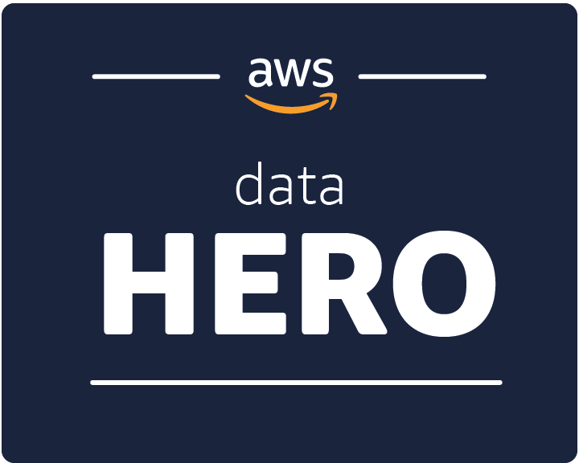




$whoami
Anurag Kale
Cloud and Data Architect
Aurobay Sweden AB
Gothenburg, Sweden
@iAnuragKale

Slide 5
Agenda
Explore the problem area
Reason we choose the data lake paradigm
Architectural walkthrough of the solution
Lessons learnt and takeaways
Notes:
Let’s build this solution together!
In order to do that we need to define the problem area – aka the bounded context of the scope
I will explain my reasons of choosing a data lake
Walkthrough of the solution
And I will try to give you a few goodies to take away

Slide 6
The problem at hand

Slide 7
The landscape and challenge
Partner
Systems
SaaS
Managed Platforms
Factory
Systems
External sources
“untrusted space”
Spaghetti mess of integrations via ESB’s
Serverless
Products
COTS
Data and Analytics
InfoSec
Internal landscape
“trusted space””
Lost RAW Data
Governance nightmare
Unclear boundaries
Process waste

Slide 8
Desired outcomes and constraints
Standardise data ingestion and distribution mechanism
Better governance
Minimise process waste
Built for multiple personas – developers, analysts, data scientists etc
Technical characteristics
  Build it as Self service platform
  Build frugally -> Serverless
  Build as loosely coupled system

Slide 9
Ideal black box solution
Partner
Systems
SaaS
Managed Platforms
Factory
Systems
External sources
“untrusted space”
Integration Options
Centralized data ingestion platform
Storage
Governance
Distribution Options
Serverless
Products
COTS
Data and Analytics
InfoSec
Polestar landscape
“trusted space”

Slide 10
Which architecture pattern can solve this?

Slide 11
Two approaches to get value from data
DWH
Data Lakes & ..
Theory
Theory
Hypothesis
Hypothesis
Observation
Pattern
Confirmation
Observation
Know the questions to ask
Do a lot of upfront work
Model First (Schema on Write)
Don’t know the questions to ask
Little upfront work
Model later (Schema on Read)
Top Down
Bottom Up
Credit : James Serra
Notes:
Do you own both the endpoints of data? i.e. Source and Target? Then DWH can work
If you only one endpoint, Data Lakes are a good bet

Slide 12
Answer : Data Lake!
DB
Report
Dashboard
FaaS
SQLaaS
ETL, CDC, Upload
Compute
Batch
Real time
IoT
Stream
Index
Object Store
Catalog
ETL, SQLaaS
DB
DWH
Stream, write
Apps
Persistance
Read, Replicate
Upload, replicate
ML Tools
DS Notebooks
IAM
Policies
Lineage
Disk
Governance

Slide 13
Let’s fine tune and implement this
Using AWS Serverless Services

Slide 14
Logical blocks
Data In
Stream
Stream
Processor
Data Store
Event Bus
Event
Near Real Time Delivery
Data Lake
ETL
Bulk Data
Landing Zone
Processing and Storage
Distribution
Catalog
Policies
RBAC
Discovery Data
Subscription Action
Control Pane

Slide 15
Logical blocks
Data In
Stream
Stream
Processor
Data Store
Event Bus
Event
Near Real Time Delivery
File In
File Upload
Data Lake
ETL
Bulk Data
Historic Data
Landing Zone
Processing and Storage
Distribution
Catalog
Policies
RBAC
Discovery Data
Subscription Action
Control Pane

Slide 16

Component design: Landing zone
Data In
Stream
Data In
Amazon Kinesis Firehose
Notes:
Kinesis Data Streams
Amazon Kinesis Data Analytics – Which is now Managed Flink in AWS
Firehose

Slide 17
Challenge # 1
Source | Challenge | Remediation
Legacy Systems | Could Not use Simple Token Service (STS) | AWS Users + APIGW façade to Kinesis
Glue Crawler | Could not flatten nested JSONs, Athena queries did not work as intended | Enforce input message format, transform to CSV/Parquet using Firehose Delivery Stream
Message Size Limit | Limited to 256 KB message size | Use Pre-signed URL and emit event notification

Slide 18


Component design: Landing zone
Data In
Stream
Data In
IAM
APIGW
Data In
Amazon Kinesis Firehose

Slide 19
Challenge # 2
Source | Challenge | Remediation
Legacy Systems | Could Not use STS | AWS Users + APIGW façade to Kinesis
Glue Crawler | Could not flatten nested JSONs, Athena queries did not work as intended | Enforce input message format, transform to CSV/Parquet using Firehose Delivery Stream
Message Size Limit | Limited to 256 KB message size | Use Pre-signed URL and emit event notification

Slide 20
Logical blocks
Data In
Stream
Stream
Processor
Data Store
Event Bus
Event
Near Real Time Delivery
File In
File Upload
Data Lake
ETL
Bulk Data
Historic Data
Landing Zone
Processing and Storage
Distribution
Catalog
Policies
RBAC
Discovery Data
Subscription Action
Control Pane

Slide 21





Component design: File Upload
Data In
Stream
Data In
Amazon Kinesis Firehose
3a
3b
7a
4b
4a
7b
5
AWS Lambda
File Upload
1
Amazon S3
File In
Amazon API
Gateway
2a
2b
Amazon SQS
Amazon DynamoDB
6

Slide 22
Component design: Processing and storage
Data In
Stream
AWS Lambda
Amazon SQS
AWS Lambda
Event Bus
Event
Amazon
DynamoDB
AWS Lambda
File In
File Upload
7b
7a
ETL
Bulk Data
AWS Lambda
Amazon S3
Landing Zone
Processing and Storage
Distribution
Catalog
Policies
RBAC
Discovery Data
Subscription Action
Control Pane

Slide 23




Component design: Distribution
Sub 1
Data In
Stream
Stream
Processor
Data Store
Sub 2
Amazon
EventBridge
Sub 3
Rules
File In
File Upload
Object Store
ETL
AWS Glue
Landing Zone
Processing and Storage
Distribution
Catalog
Policies
RBAC
Discovery Data
Subscription Action
Control Pane

Slide 24




Component design: Control pane
Data In
Stream
Stream
Processor
Data Store
Event Bus
Event
File In
File Upload
Object Store
ETL
Bulk Data
Landing Zone
Processing and Storage
Distribution
AWS Glue
Crawler
AWS Glue
Data Catalog
Amazon
Athena
AWS Lake
Formation
Amazon API
Gateway
AWS Lambda
Control Pane

Slide 25
Challenge # 3
Source | Challenge | Remediation
Legacy Systems | Could Not use STS | AWS Users + APIGW façade to Kinesis
Glue Crawler | Default partition into S3 by year, month, date and hour did not work well for crawler | Enforce input message format, transform to CSV/Parquet using Firehose Delivery Stream
Message Size Limit | Limited to 256 KB message size | Use Pre-signed URL and emit event notification

Slide 26
Default S3 way of storing
Date=2024-10-03
Hour=10
  Source 1
    data_file
  Source 2
    data_file
Hour=11
  Source 3
    data_file
  Source 4
    data_file
    data_file
  Source 1
    data_file
Hour=12
  Source 4
  Source 2
Source 1
Date=2024-10-03
  Hour=10
    data_file
    data_file
  Hour=11
    data_file
    data_file
Source 2
Date=2024-11-03
  Hour=16
    data_file
    data_file
  Hour=18
    data_file
    data_file

Slide 27
Input message format
{
metadata:{
//required
“id”: “uuid”,
“timestamp”: “1549389747972”,
“source”: “PaymentSaas”,
“resource”: “/gettxnid”,
“eventtype” : “IntegraionEvent”
//optional
“version” : “1”,
“jurisdiction” : “EU”,
“tags” : [“”],
“datasensitivity” : “public”
},
data:{
// custom data
}
}

Slide 28
Component design: File Upload
Data In
Stream
Data In
Amazon Kinesis Firehose
3a
3b
7a
4b
4a
7b
5
AWS Lambda
File Upload
1
Amazon S3
File In
Amazon API
Gateway
2a
2b
Amazon SQS
Amazon DynamoDB
6

Slide 29
The outcome
Landing Zone
Processing and Storage
Distribution
Sub 1
Data In
Sub 2
Data In
Amazon Kinesis
Firehose
AWS Lambda
Amazon SQS
AWS Lambda
Amazon
EventBridge
Sub 3
Amazon SQS
Rules
Amazon
DynamoDB
AWS Lambda
File
File In
Amazon
DynamoDB
ETL
Amazon API
Gateway
AWS Lambda
AWS Glue
AWS Lambda
Amazon S3
Control Pane
AWS Glue Crawler
AWS Glue
Data Catalog
Amazon
Athena
AWS Lake
Formation
Amazon API
Gateway
AWS Lambda
6

Slide 30
Some stuff we will add
Automate onboarding for new producers
  Service Now for “classic” users
  Github PR based STS Role vending
Automate onboarding for consumer systems
  API actions to manage EB Rules
  Github PR based EB rule management
Add Glue Data Quality Checks per source
Mechanisms for full transparency of key metrics
API based controls to consumers to retry failed messages

Slide 31
Closing Thoughts
Centralized vs decentralized data lakes
  Centralized – if data lake is intended to serve as source of truth
  Decentralized - if you plan to use it as a staging area
Pay attention to UX / DX
  Different personas have different skills and needs
  Poor UX / DX turns data lakes to data swamps
Open Table formats
  Apache Iceberg has the best integrations
  Other formats are supported but there are several limitations

Slide 32

Please take a moment to share your feedback

Slide 33
Thank You!
Questions?
iAnuragKale

